Slide 1

Analysis Of Rental Houses in Pune
By
Yogita Rajesh Dhamale

Slide 2
About me
I Have Completed my MSC in Statistics From Modern College Of Arts, Science and Commerce , Pune
After completing my MSc in Statistics, where I learned how to analyze and understand data, I realized that I enjoy working with data not only theoretically but also practically, and finding meaningful insights from it. Therefore, I choose Data Analytics, as it allows me to apply my statistical knowledge to real-world data and support better decision-making.
LinkedIn profile URL : www.linkedin.com/in/yogita-dhamale-b151a2219
GitHub profile URL : https://github.com/Yogi14-93

Slide 3
Objective
The main goal of this project was to understand how rental prices change across different areas of Pune.
To identify factors influencing rental prices such as location, amenities, and property size.
To compare rental rates based on property types (2 BHK, 3 BHK, 4 BHK etc.).
To identify high-demand and premium rental areas in Pune.

Slide 4
Web Scraping Process
Sending Request & Fetching Data
Selecting Website
https://www.Nestoria.in
Importing Libraries
(Requests, BeautifulSoup & Pandas)
Extracting Data
Converting Data into DataFrame
Cleaning & Formatting Data
Save & Analyse Data

Slide 5
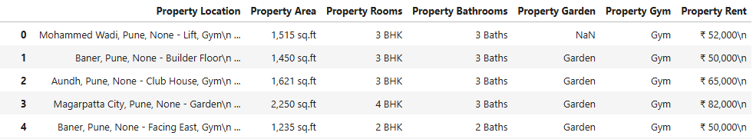
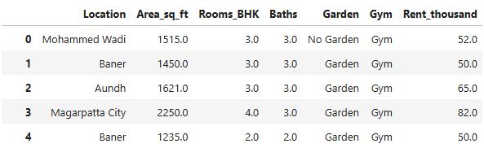
Before Cleaning the data
After Cleaning the data

Slide 6
Data Cleaning & Data Manipulation Steps
Fixed missing values and formatting issues.
Cleaned rent, area, BHK, Bathroom and location details.
Converted columns to correct data types for analysis.
Created new columns and organized data for analysis.

Slide 7
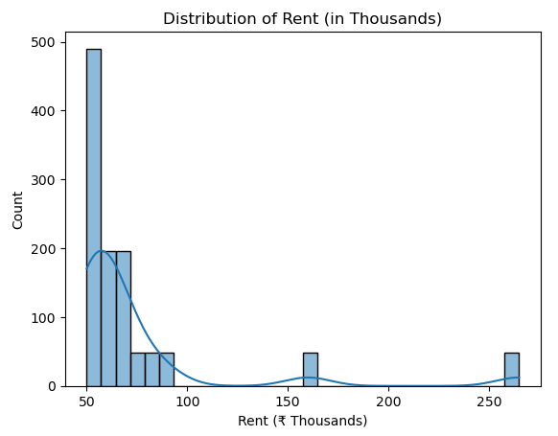
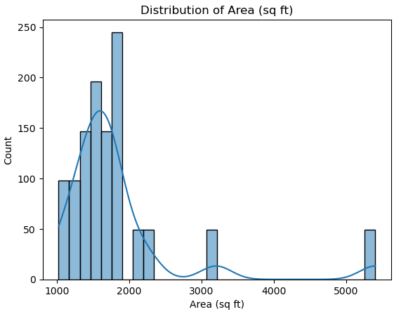
Rent & Area Distribution
The rent distribution is positively skewed (right- skewed).
Most properties have moderate rent and medium-sized area, while very expensive and very large homes are few.
The majority of rentals fall between ₹50k–₹80k, and most properties are sized 1000–2000 sq ft.
A small number of high-rent, large-area properties create a long tail in both distributions.

Slide 8
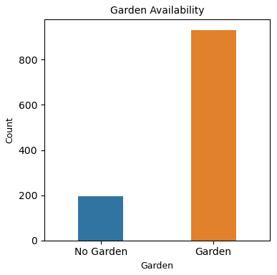
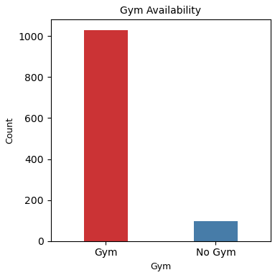
Garden & Gym Availability
Most properties have a garden, while only a few do not.
Gym facilities are available in most properties, with very few listings without a gym.
Gardens and gyms are common amenities in most properties.
This indicates that amenities are becoming standard features in Pune rental properties.

Slide 9
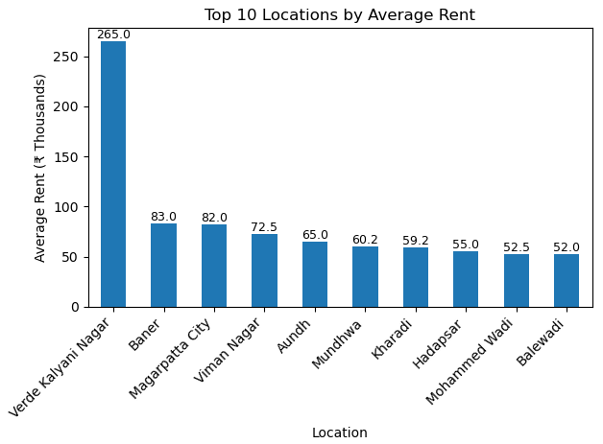
Rent vs Top 10 Locations
Verde Kalyani Nagar has the highest average rent, much higher than all other locations.
Baner, Magarpatta City, and Viman Nagar are the next high-rent areas.
Most other locations have average rents between ₹50k and ₹65k.
This shows a clear rent difference by location, with only a few premium areas being very expensive.

Slide 10
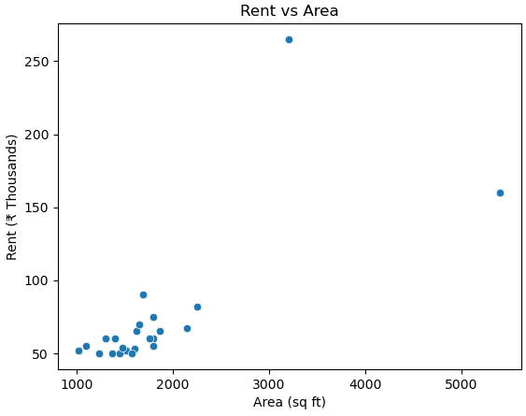
Relationship Between Area & Rent
As area increases, rent generally increases.
Most properties are 1000–2000 sq ft with rent around ₹50k–₹80k.
Very large homes have much higher rent, but they are few.
A few high-rent outliers stand out at larger areas.

Slide 11
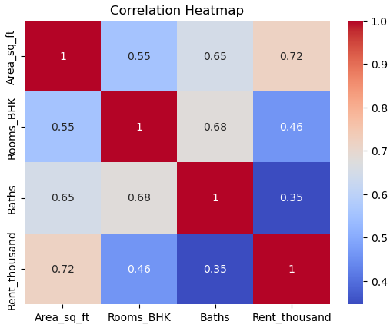
Relationship Between Rent & Property Features
Rent increases with property size — larger area homes usually have higher rent.
Properties with more rooms and bathrooms tend to have higher rent, but the effect is moderate.
Area has the strongest impact on rent compared to rooms and bathrooms.
property size is the key factor affecting rent.

Slide 12
Conclusion
Rent prices in Pune change a lot from one area to another.
Bigger houses and more rooms usually have higher rent.
Most houses are in the medium rent range.
Some locations have higher rent because of better facilities.
Amenities like parking and gym increase the value of the house.

Slide 13
Experiences and Challenges
Experiences
Gained hands-on experience in web scraping real-world data.
Learned to work with unstructured and messy data.
Improved skills in data cleaning, analysis, and visualization.
Understood how data supports business decision-making.
Challenges
Handling missing and inconsistent data from web scraping.
Converting raw data into analysis-ready format.
Cleaning location names
Choosing the right visualizations for clear insights.

Slide 14

THANK YOU

